Slide 1
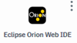
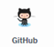

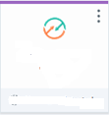


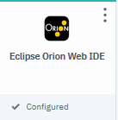
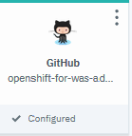
Brokers:
Tekton
events
webhook
app1
Start with IDE and app repository

Slide 2
Openshift
Brokers:
Tekton
events
webhook
kabanero
app1
Install Kabanero

Slide 3
Openshift
Brokers:
Tekton
events
webhook
kabanero
Kab1
app1
Create Kabanero instance

Slide 4
Openshift
Brokers:
Tekton
events
webhook
kabanero
Kab1
kab1
app1
Event- Trigger
pipeline
Create Kabanero service

Slide 5
Openshift
Brokers:
Tekton
events
webhook
kabanero
Kab1
kab1
app1
Event- Trigger
pipeline
Create Github service for Tekton

Slide 6
Openshift
Brokers:
Tekton
events
webhook
kabanero
Kab1
kab1
app1
Event- Trigger
pipeline
Create Github service for event trigger

Slide 7
Openshift
Brokers:
Tekton
events
webhook
kabanero
Kab1
Listener PR
Tekton
Listener Push
kab1
Listener Tag
app1
Event- Trigger
pipeline
Create Tekton service and listeners

Slide 8
Openshift
Brokers:
Tekton
events
webhook
kabanero
tri
Kab1
Listener PR
trigger1
Tekton
Listener Push
events
kab1
Listener Tag
app1
org
Event- Trigger
pipeline
Create Events service + triggers

Slide 9
Openshift
Brokers:
Tekton
events
webhook
kabanero
tri
Kab1
Listener PR
trigger1
Tekton
Listener Push
events
kab1
Listener Tag
app1
org
Event- Trigger
pipeline
Create NATS webhook topic

Slide 10
Openshift
Brokers:
Tekton
events
webhook
kabanero
tri
Kab1
Listener PR
trigger1
Tekton
Listener Push
events
kab1
Listener Tag
app1
org
Event- Trigger
pipeline
Create Github Org

Slide 11
Openshift
Brokers:
Tekton
events
webhook
kabanero
tri
Kab1
Listener PR
trigger1
Tekton
Listener Push
events
kab1
webhook
Listener Tag
app1
org
Event- Trigger
pipeline
Create Org Webhook

Slide 12
Openshift
Brokers:
Tekton
events
webhook
kabanero
tri
Kab1
Listener PR
trigger1
Tekton
Listener Push
events
kab1
webhook
Listener Tag
app1
org
Event- Trigger
pipeline
Link event senders/receivers

Slide 13
Backup

Slide 14
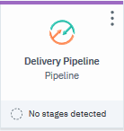
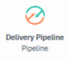
Tekton
events
events
webhook
Tekton
publisher
subscriber
sender
listener
event
event
webhook

